Slide 1
Heat Pump Exercise Sessions
Thermal Systems: Basic Aspects (H9X52A)
Toegepaste Thermodynamica (I0P29A)

Slide 2
What is a heat pump?

Slide 3
Schematic of heat pump
SINK
The heat pump takes heat from a source and pumps it to a sink
Consequently the temperature at the sink is higher than the temperature at the source
T_{H} > T_{L}
Is this normal?
NO – heat flows naturally from hot to cold, not the other way around (i.e. the heat pump case)
So what is missing?
An input of energy is needed in order to make this unnatural process happen
Q_{H}
HEAT PUMP
Q_{L}
SOURCE
Q_{H} = heat high Q_{L} = heat low
Notes:
The main goal of a heat pump is to use heat from a source at low temperature to deliver heat at high temperature at the sink side of the heat pump

Slide 4
What are the components of a heat pump?
Condenser
Evaporator
Expander
Compressor

Slide 5
Heat Pump: the details
5
6
There are 3 circuits having three different compounds flowing through them (ṁ = mass flow):
ṁ_{ref} (1 to 4) = refrigerant
Freon, butane, propane….
Steps 1-2 VAPOUR → crucial for functional compressor
Steps 3 LIQUID
Step 4 LIQUID + VAPOUR
ṁ_{WC} (5 to 6) = water
Water which goes to our radiators
ṁ_{WE} (7 to 8) = water + alcohol
We add an alcohol ( e.g. ethanol) to lower the freezing point - ensure smooth functioning of evaporator
ṁ_{WC}
Condenser
3
Q_{H}
2
ṁ_{ref}
Compressor
Ẇ
Expander
Q_{L}
4
Evaporator
1
ṁ_{WE}
8
7
Notes:
The refrigerant evaporates at low pressure and at a temperature lower than the source temperature level – extracts the heat at low temperature
The refrigerant is then compressed – gas condenses at high pressure and at a temperature higher than the sink – delivering heat

Slide 6
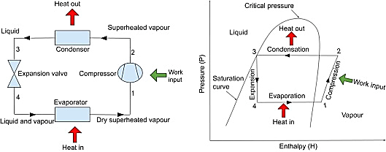
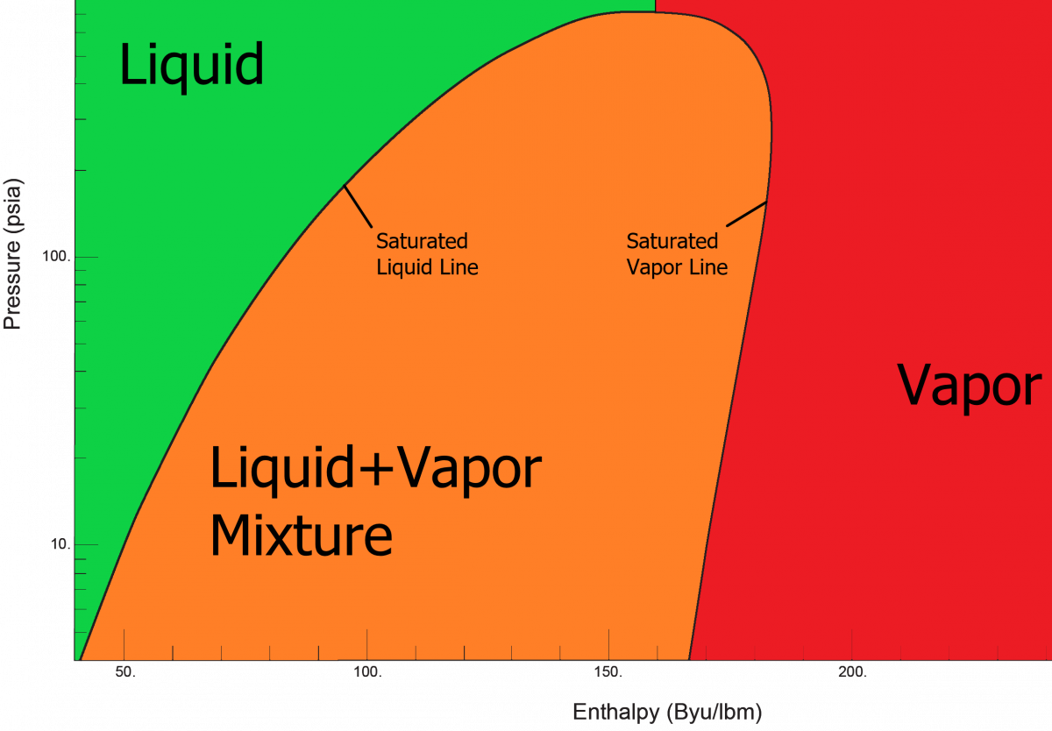

Q_{L}
W
$$PV=nRT$$
Q_{H}

Slide 7
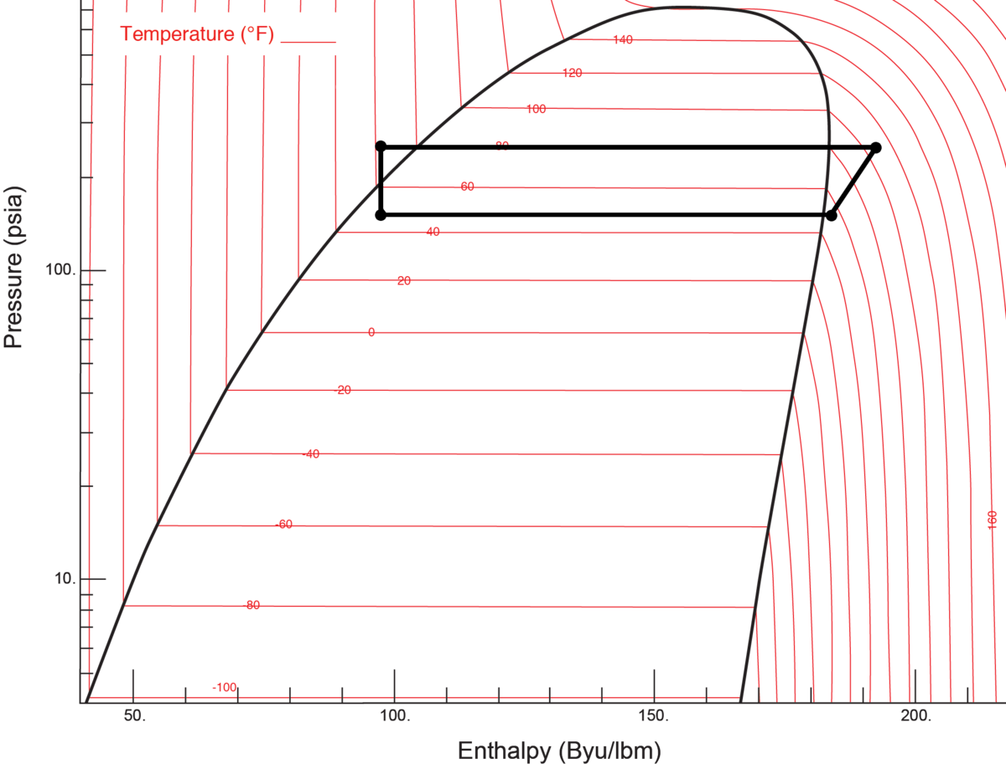
Q_{L}
W
$$PV=nRT$$
Q_{H}

Slide 8
Pressure-enthalpy diagrams
Processes:
1-2 → compression → isentropic
2-3 → condensing → isobaric
3-4 → expansion → isenthalpic
4-1 → evaporating → isobaric
Q_{L}
W
Q_{H}

Slide 9

How do we measure the performance of a HP?
Heat power delivered by condenser (Q_{H} or Q_{C})
$$Performance= \frac{output}{input}$$
Electric power of compressor (Ẇ)

Slide 10
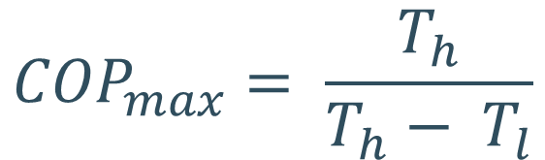
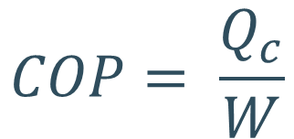
Coefficient of performance (COP)
The performance of a heat pump is formally known as the COP:
The maximum theoretical performance is defined by Carnot’s equation:
$$COP= \frac{Q_{c}}{W}$$
$${COP}_{max}= \frac{T_{h}}{T_{h}− T_{l}}$$

Slide 11
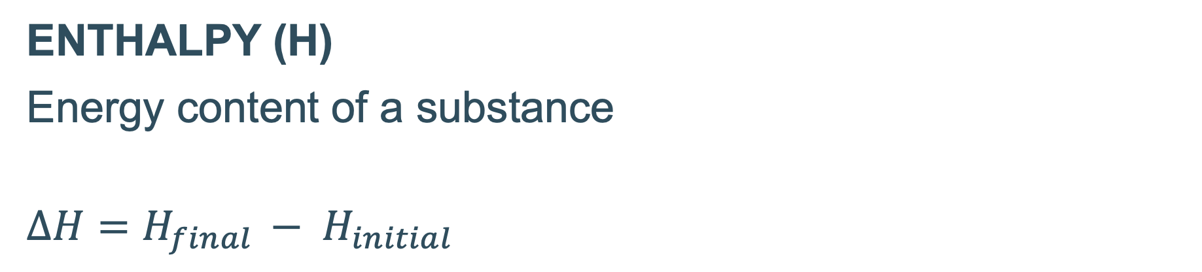
So how can we obtain Ẇ and Q_{C}?
ENTHALPY (H)
Energy content of a substance
$$∆H=H_{final }− H_{initial}$$
Q_{L}
W
Q_{H}

Slide 12
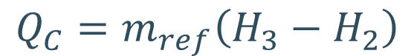
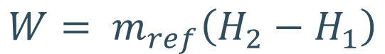
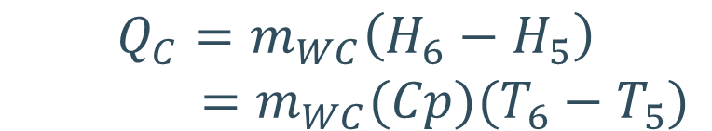
Obtaining Ẇ and Q_{C}
$$W= m_{ref}\left(H_{2}−H_{1}\right)$$
5
6
ṁ_{WC}
Condenser
Two ways of calculating Q_{C}
3
Q_{H}
2
1. Using refrigerant mass flow
ṁ_{ref}
$$Q_{C}=m_{ref}\left(H_{3}−H_{2}\right)$$
Compressor
Ẇ
2. Using condenser water mass flow
Expander
$$Q_{C}=m_{WC}\left(H_{6}−H_{5}\right)$$
$=$ $m_{WC}(Cp)(T_{6}−T_{5})$
Q_{L}
4
Evaporator
1
Can use the specific heat capacity of water (Cp) - H₂O is a non-compressible liquid
ṁ_{WE}
8
7

Slide 13
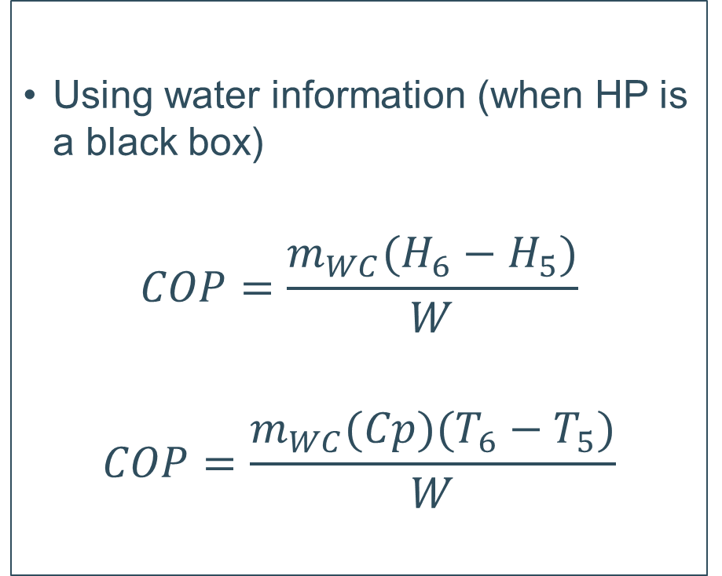
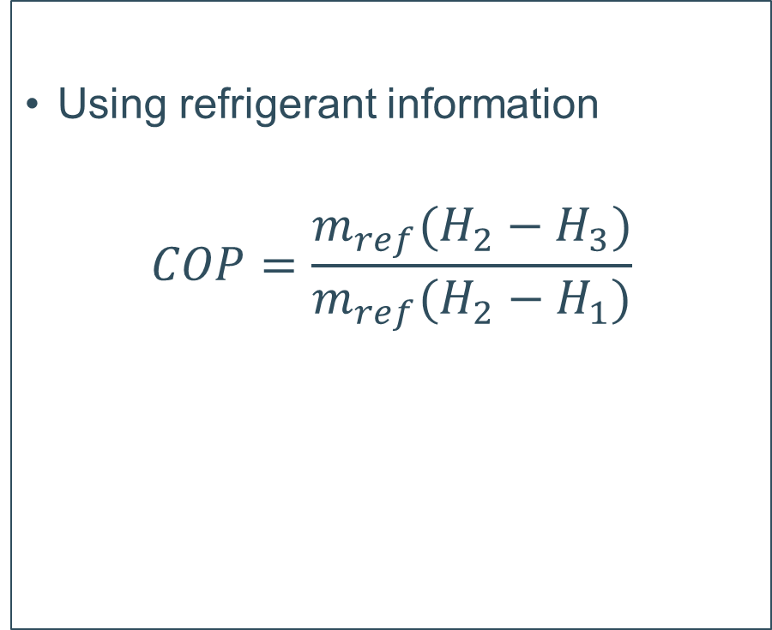

Calculating COP: two possibilities
$$COP= \frac{Q_{c}}{W}$$
Using refrigerant information
$$COP=\frac{m_{ref}(H_{2}−H_{3})}{m_{ref}(H_{2}−H_{1})}$$
Using water information (when HP is a black box)
$$COP=\frac{m_{WC}(H_{6}−H_{5})}{W}$$
$$COP=\frac{m_{WC}(Cp)(T_{6}−T_{5})}{W}$$

Slide 14
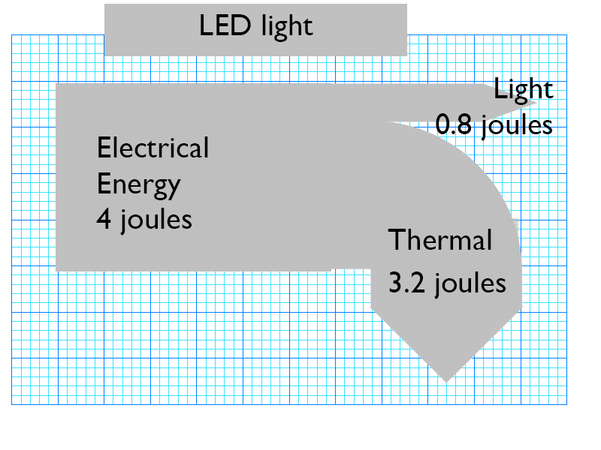
Sankey diagram
Condenser
Expander
Compressor
A flow diagram → width of arrow is proportional to flow quantity
Show the energy flows between the HP components using a Sankey diagram
Consider what is going in/out of each component of the HP as well as losses
Will be a cycle
LED light example
Evaporator
http://www.myphysics.org.uk/ks4p3hotpot04.htm

Slide 15
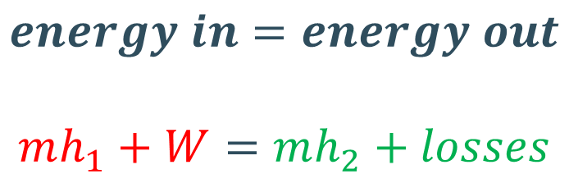
E.g. Sankey for compressor
Law of conservation of energy – total energy of an isolated system is constant, energy can be transformed from one form to another but it cannot be created or destroyed.
$$energy in=energy out$$
$$mh_{1}+W=mh_{2}+losses$$
Compressor

Slide 16
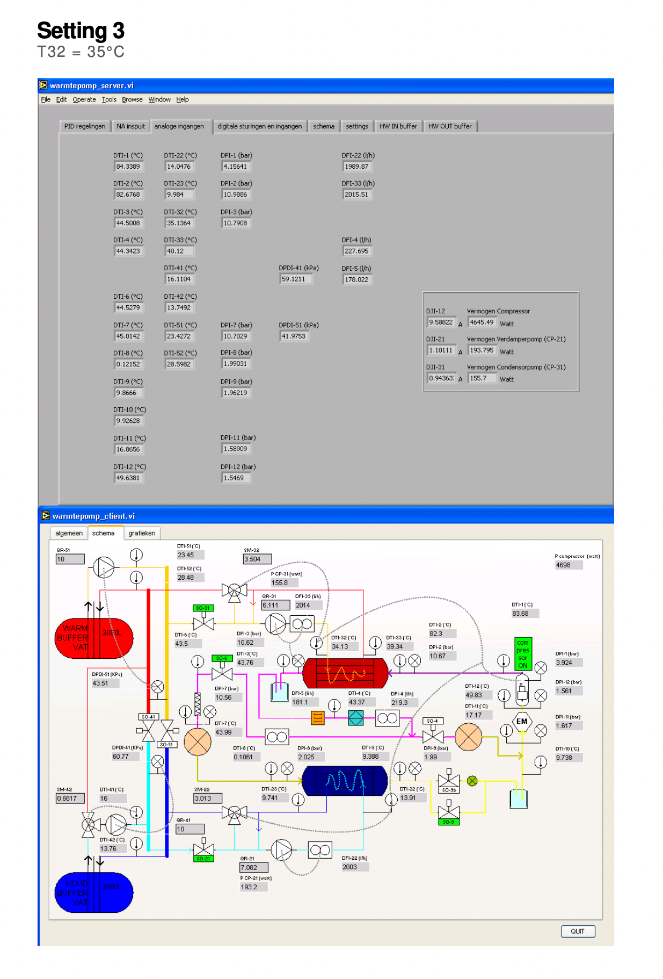
Your turn!
Download all matlab files from Toledo (Calculations_template)
Instructions and questions → 2 weeks
*Used to be able to access a heat pump
Change input parameter, observe new steady state, defined by outputs:
4 pressures, 8 temperatures, 3 flows, W
5 settings = cols, in each setting find the outputs
Input all data → perform calculations
First theory part requires no data

Slide 17
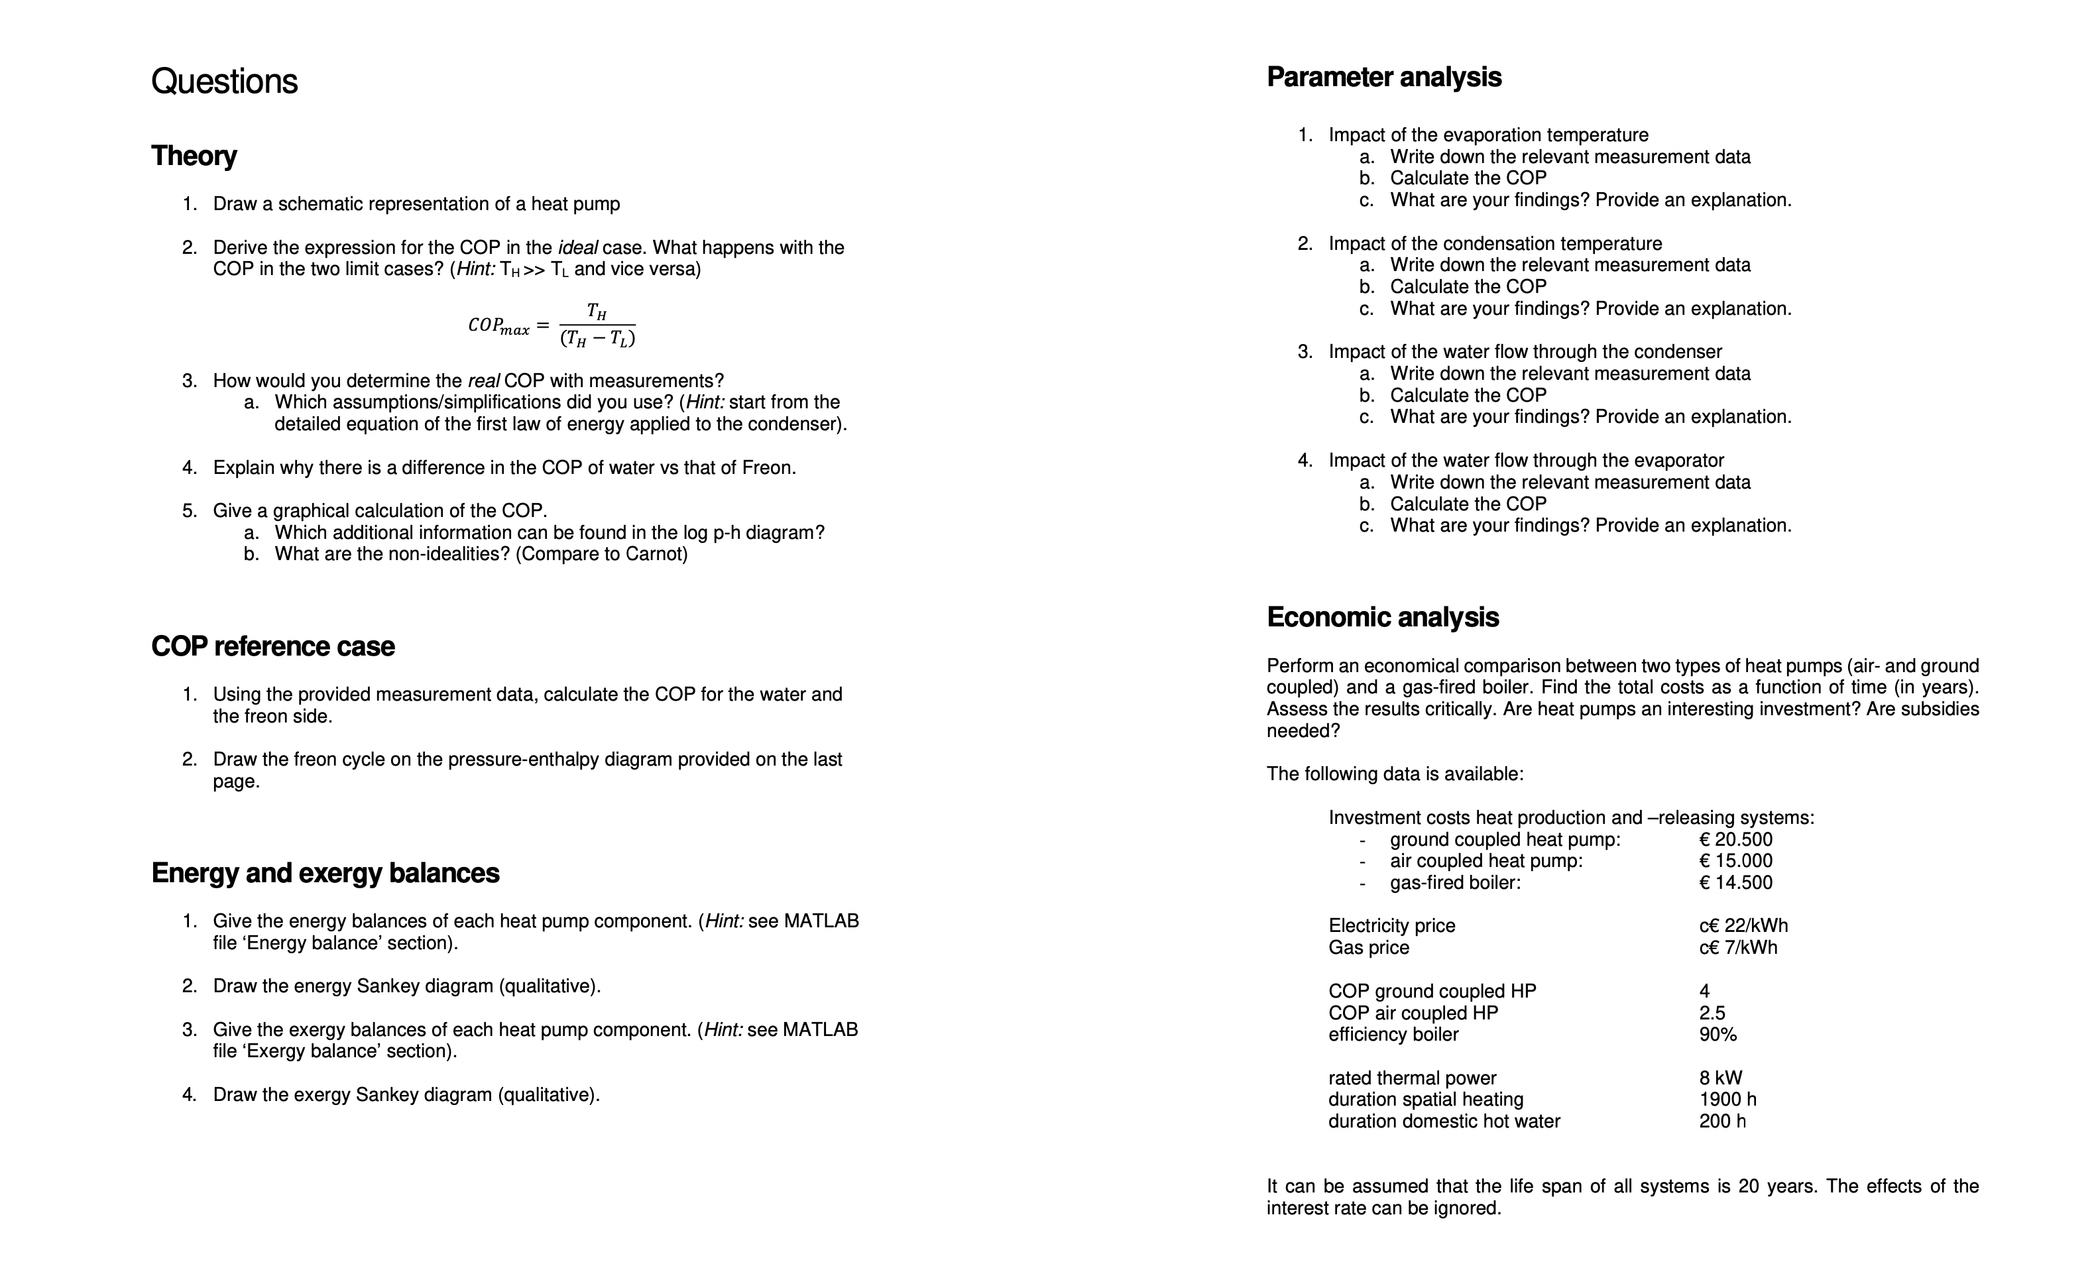
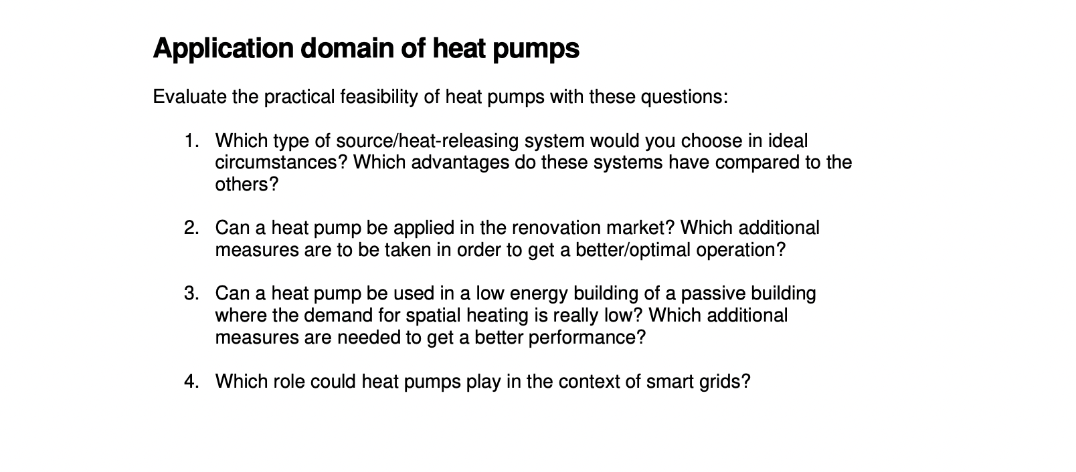

Slide 18
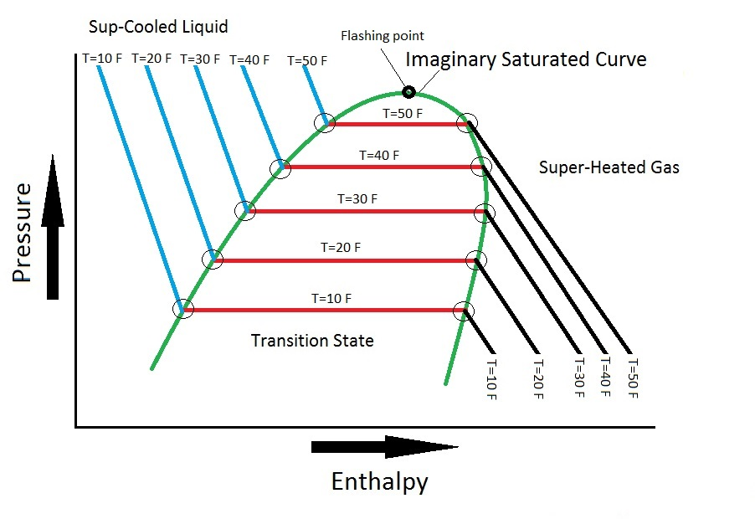
Temperature behavior
http://www.heatpump-reviews.com/pressure-enthalpy-chart.html

Slide 19
Q_{L}
W
Q_{H}
https://www.sciencedirect.com/science/article/pii/B9780081003114000017

